Slide 1

Final Year Project
By David Whiteford

Slide 2
The game that I am creating will be a legend of Zelda type of game that will have a procedural Generation system.
This will be used to generate the dungeons that will be able to be played.
The game will be made of a overworld that the player can explore and get loot from shops.

Slide 3
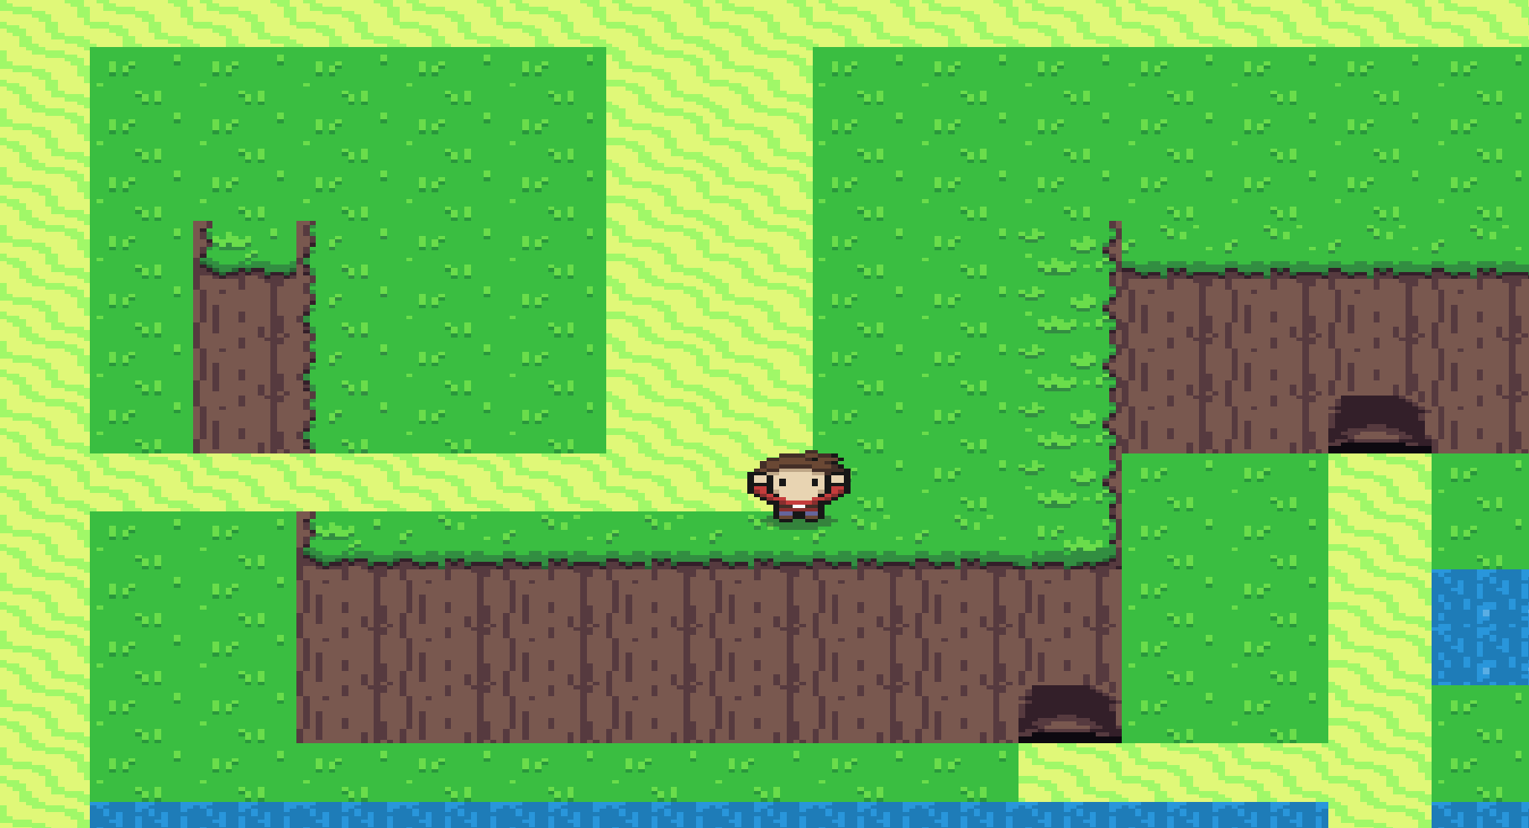
Overworld
This will be a open world that the player can explore.
There can be buildings that are used to buy upgrades for the player.
The overworld will have enemies that the player can fight but these will be weaker than the dungeon enemies.
The dungeons can be accessed from here from caves.

Slide 4
Dungeons
These will be procedurally generated.
They will be accessed from a overworld that the player can explore.
These will be generated when the player enters a cave.
They will have bosses and there will also have loot that will be available in these.
They are different every time the player enters them. There will also be loot that the player can get form these levels.

Slide 5
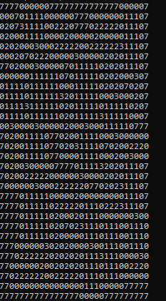
Dungeon Generation
The dungeons are procedurally generated when the player enters a cave.
This will give back numbers that are inserted into 2D array.
I then pass this array to the tilemap class to be used to generate the dungeon.

Slide 6
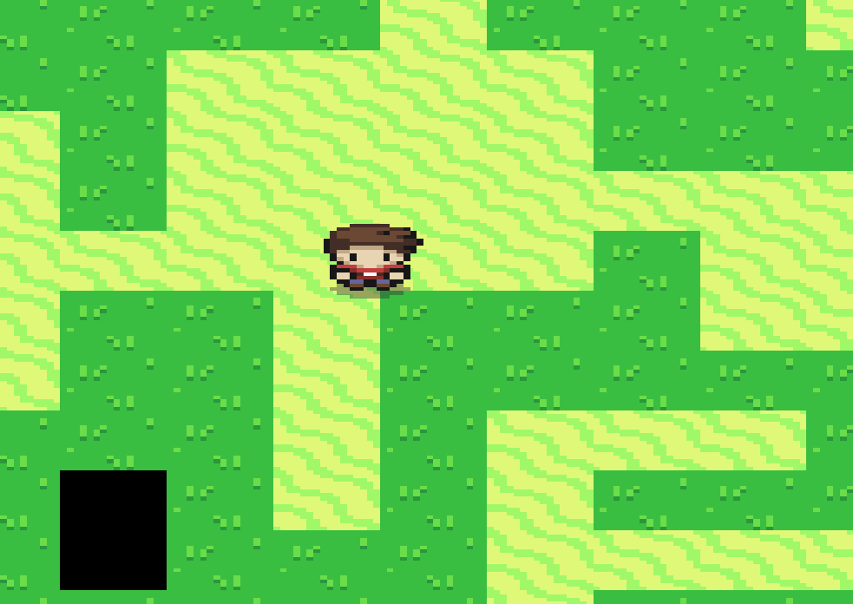
Dungeon Generation(continued)
The dungeon will be generated using the 2D array from a Dungeon Generation class.
This is used to create the dungeon.
The image is of the procedural generation and what it produces but with temporary tiles.
It produces rooms and halls.

Slide 7
Enemies
The game will have a number of different enemies that the player can fight.
These can be zombies, ghouls, ghosts and others.
These will have varying difficulty and will be harder in the dungeons than in the overworld.

Slide 8
Bosses
There can also be bosses that the player can fight.
These will spawn in the dungeons.
They will drop loot like weapons and gold
There will be a unique way to kill these e.g. a boss could be weak to fire and are killed by using fire(flame arrows).

Slide 9
Loot
The game will be filled with loot that the player can get so as to make them selves stronger as they play.
The best loot will be in the dungeons that can have a boss spawn in them.
The player gets this loot to become strong enough to beat all the bosses and their minions.

